Slide 1
CAPSTONE 1
Models on machine learning
Data:-Heart disease prediction

Slide 2
Introduction
Heart disease, also referred as cardiovascular diseases, is broad term used for diseases and conditions affecting the heart and circulatory system. It is a major cause of disability all around the world. Since heart is amongst the most vital organs of the body, its diseases affect other organs and part of the body as well. There are several different types and forms of heart diseases. The most common ones cause narrowing or blockage of the coronary arteries, malfunctioning in the valves of the heart, enlargement in the size of heart and several others leading to heart failure and heart attack.

Slide 3

Steps Done…
Data Analysis
Data Preprocessing
Data Visualization
Model
Training
Importing dependencies and Data reading
Checking missing values
replacing null values with mean or mode
Checking if the data is imbalance then performing undersampling or oversampling
Feature selection
Visualizing data with different types of plots/graphs
Building model by training the train data and evaluating on the testing data

Slide 4
Data Reading and Preprocessing
There are total 319795 rows and 18 columns
There are no missing values and null values
GenHealth and Race were dropped as they were not considered important
Converting columns with object data type into integer by label encoding

Slide 5
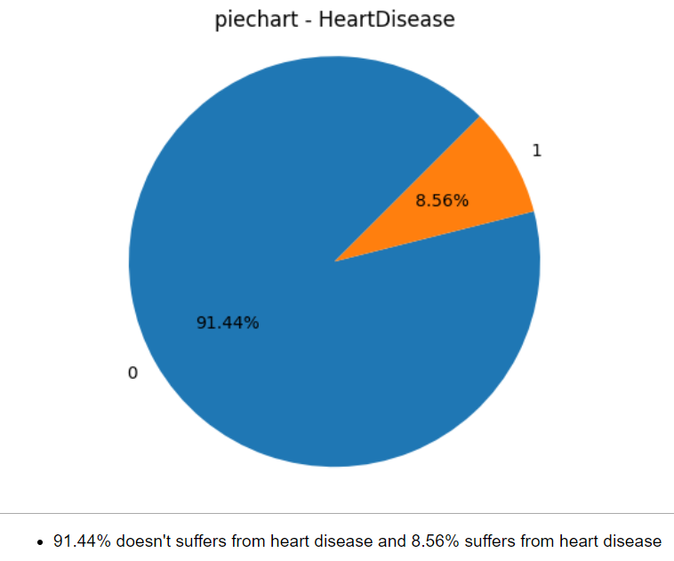
Data imbalance
As we can see data is highly imbalance so resampling is done to make the data balance
Both undersampling and oversampling is performed and analysis is done.

Slide 6
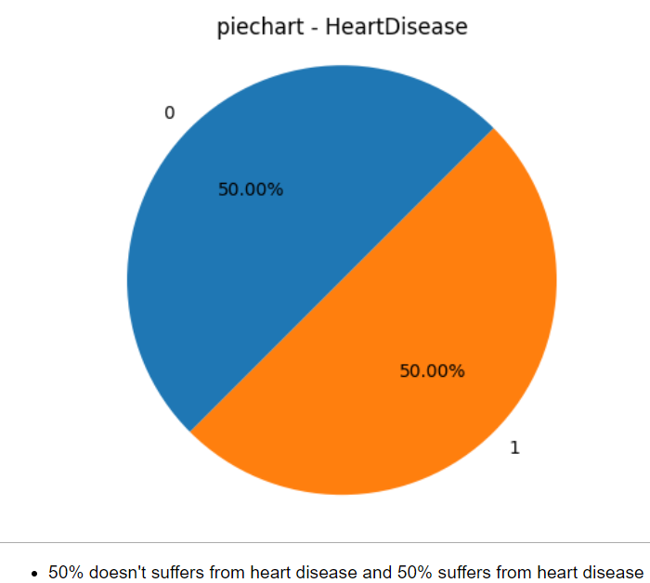
Solving Data Imbalance
As we can see after resampling the data is now Equally distributed

Slide 7
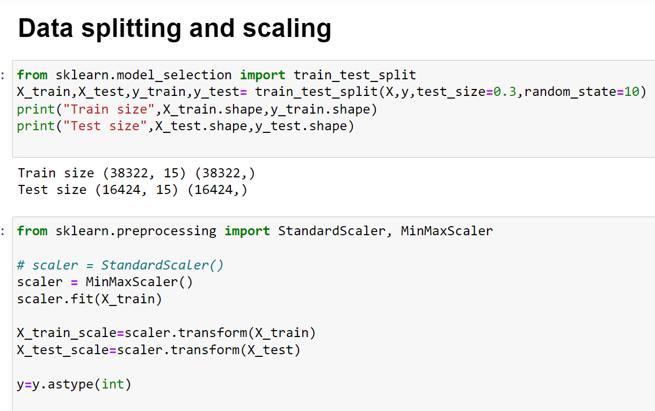
Data splitting and scaling
Data is splitted into train data and test data
Here as we can see the dependent train data contains 38322 rows and 15 columns whereas dependent test data contains 16424 rows and 15 columns
Data scaling is done and all the values are converted between 0 to 1 so the model trains fast.

Slide 8
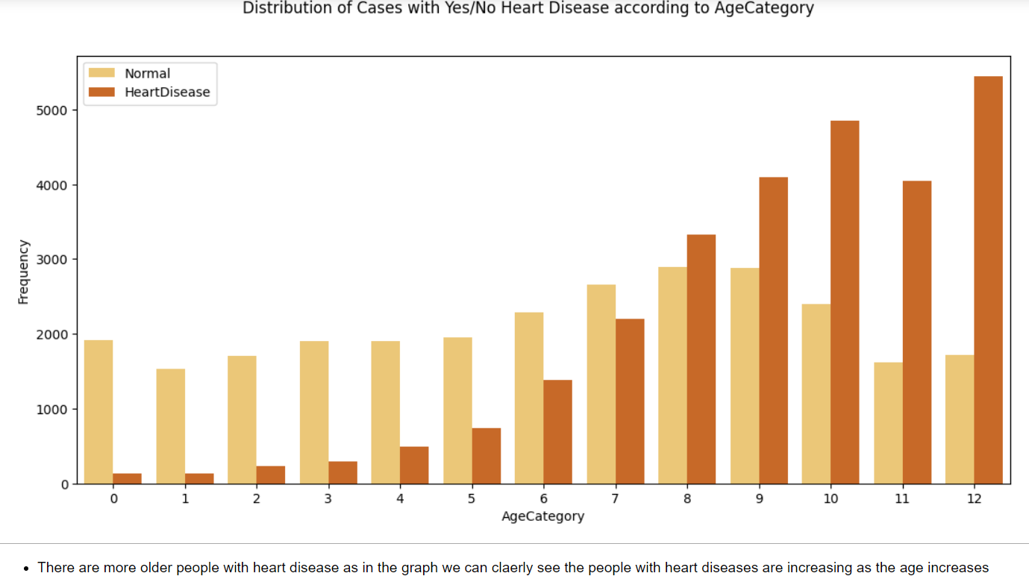
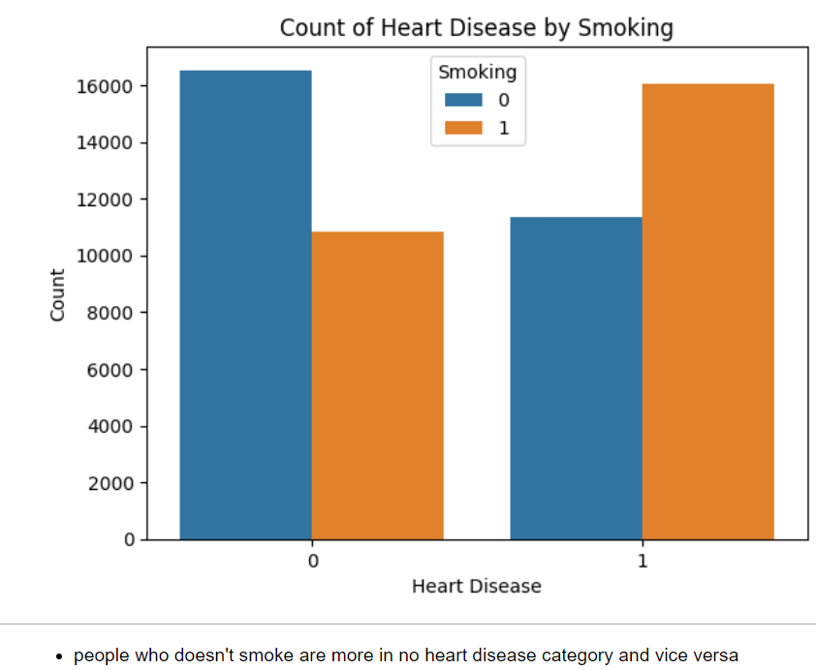
Undersampling(Data visualization)

Slide 9
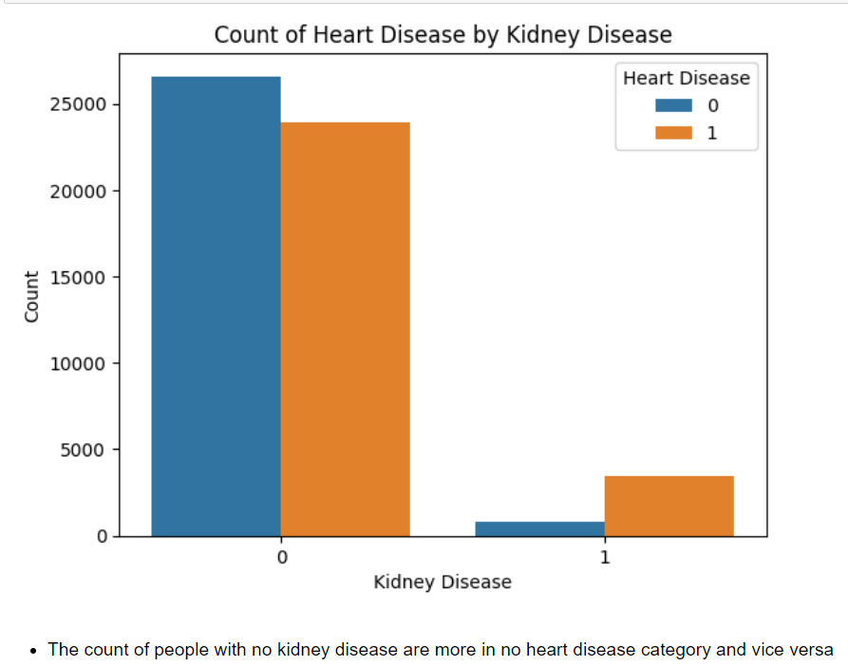
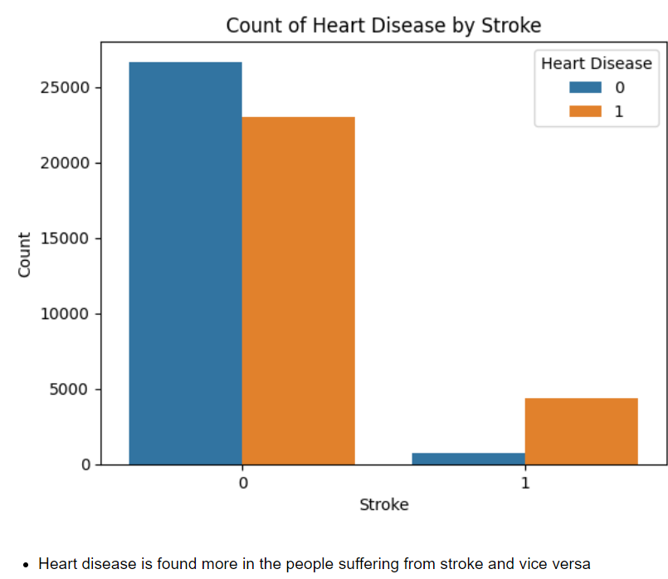
Undersampling(Data visualization)

Slide 10
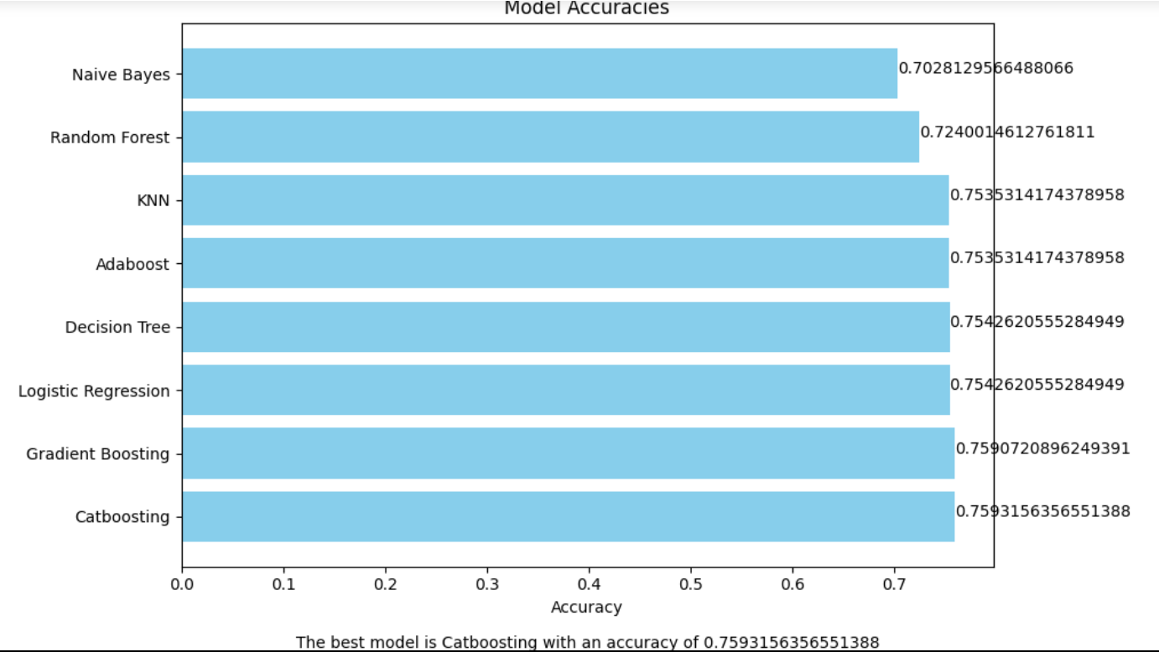
Model Evaluation (undersampling)
As we can see 8 different models were used and out of which catboosting came out to be the best model with an accuracy of 0.75%

Slide 11
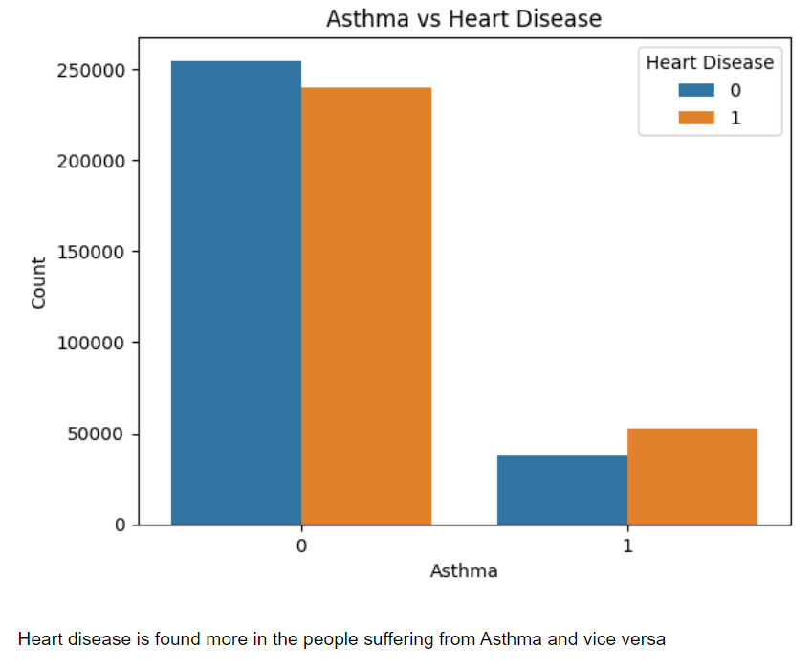
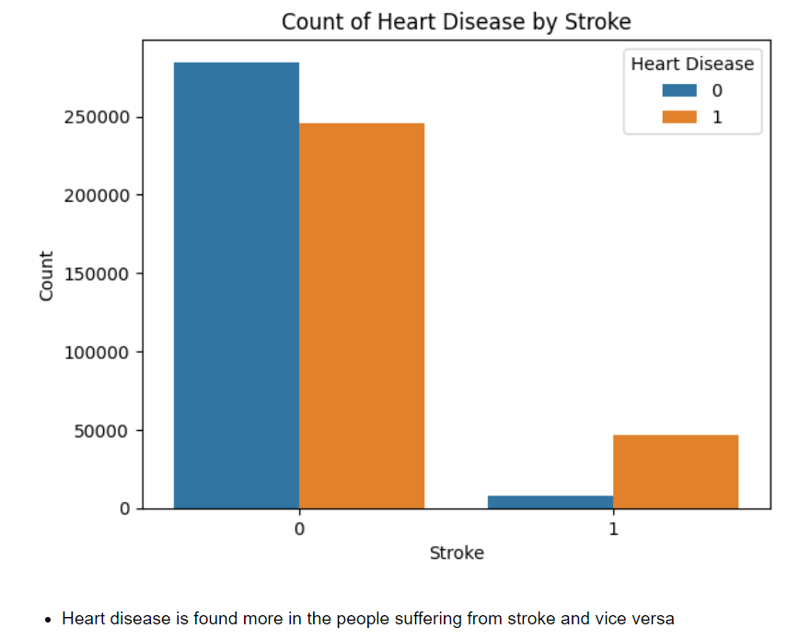
Oversampling(Data visualization)

Slide 12
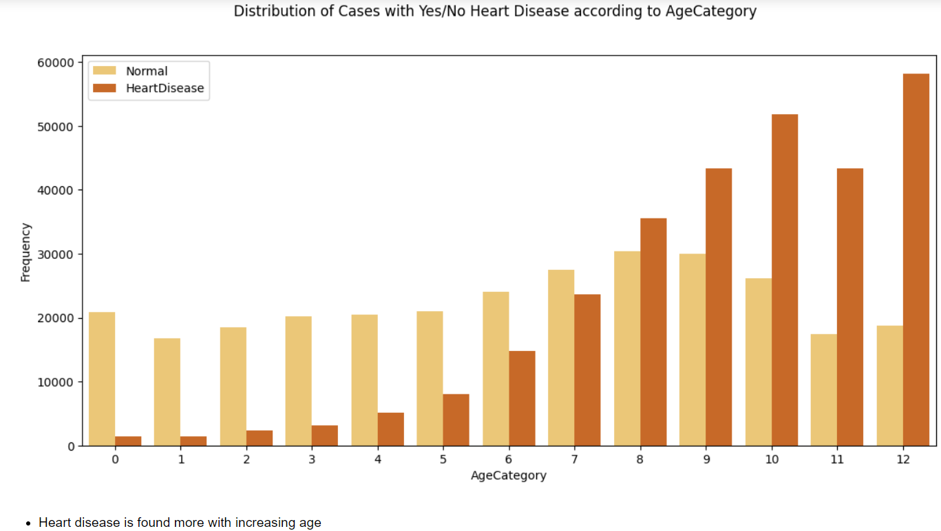
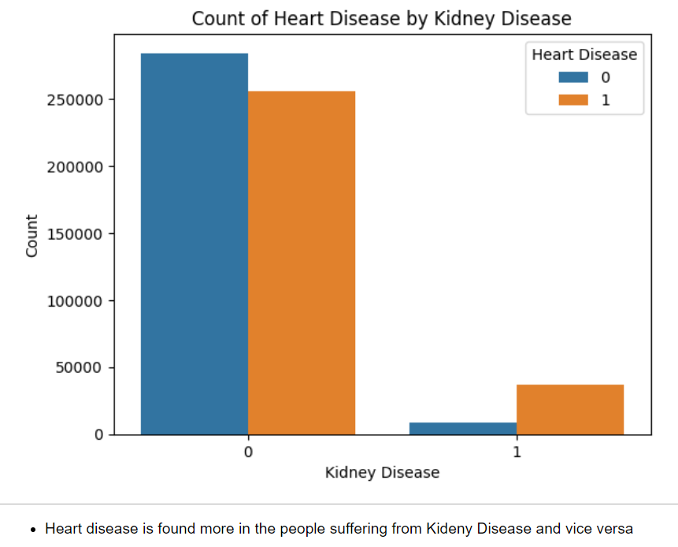
Oversampling(Data visualization)

Slide 13
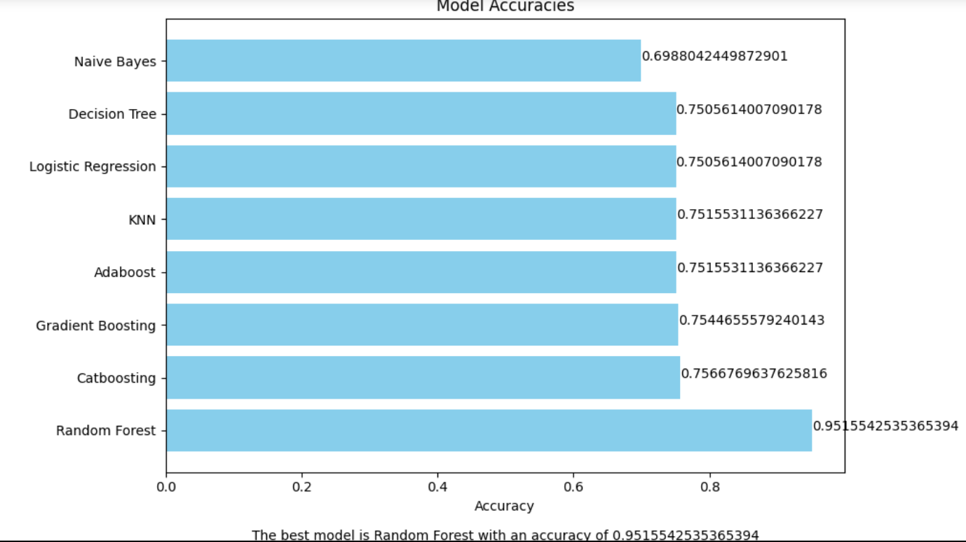
Model Evaluation (oversampling)
Random forest came out to be the best model with an accuracy of 0.95%

Slide 14
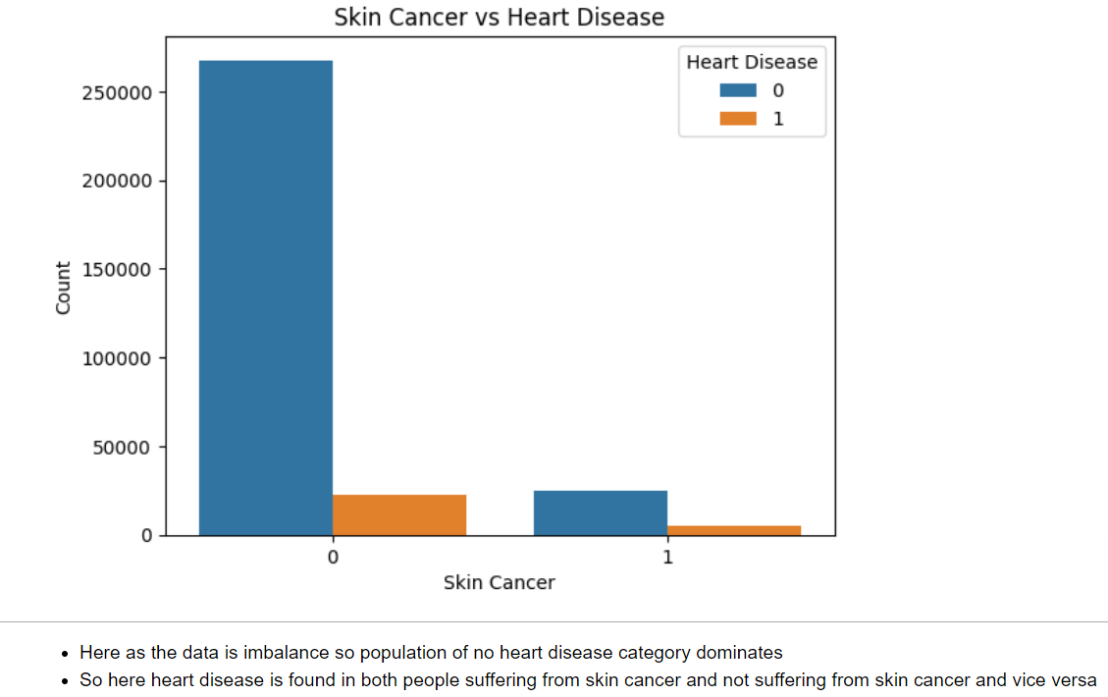
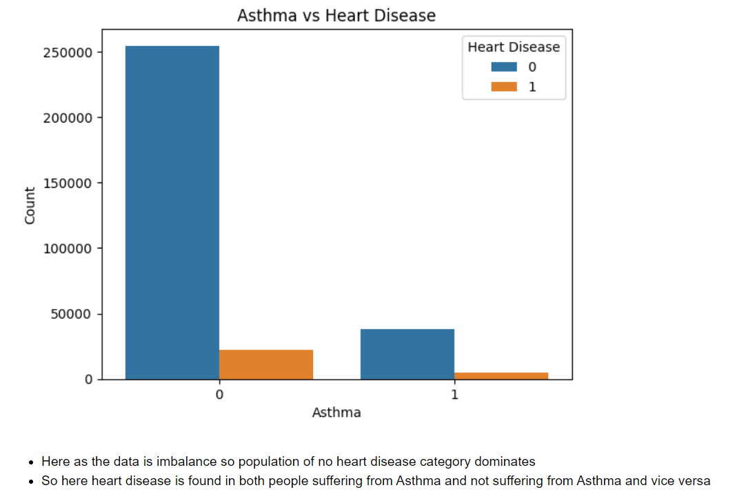
No-Resampling(Data visualization)

Slide 15
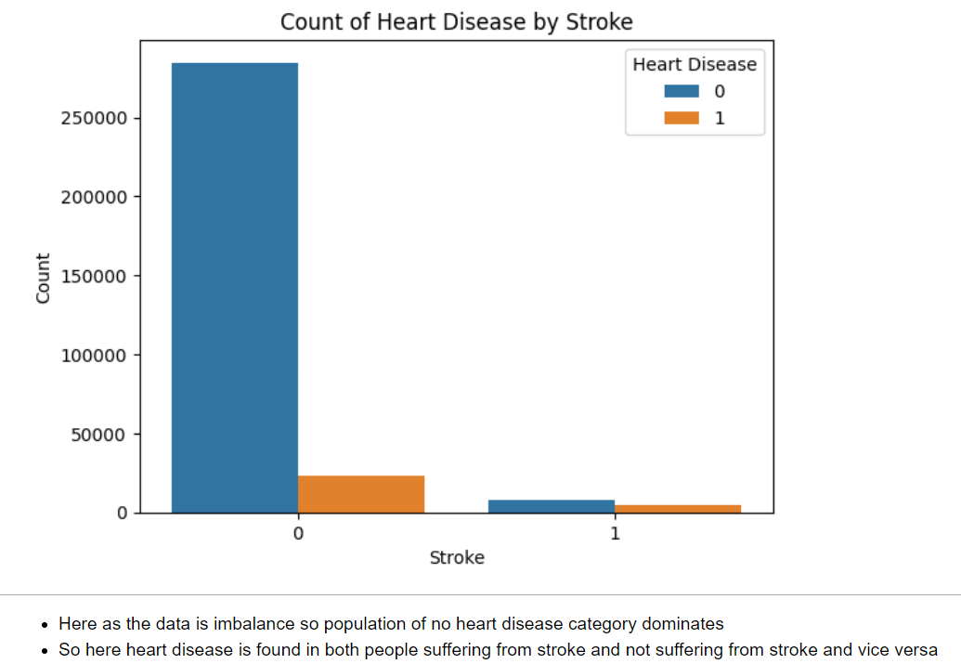
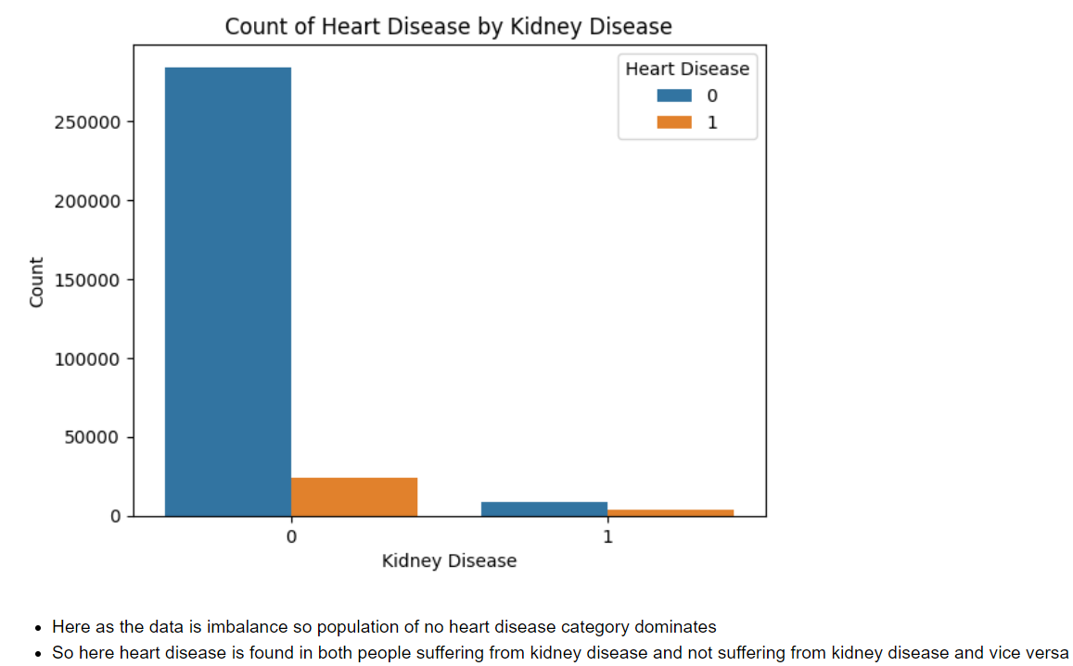
No-Resampling(Data visualization)

Slide 16
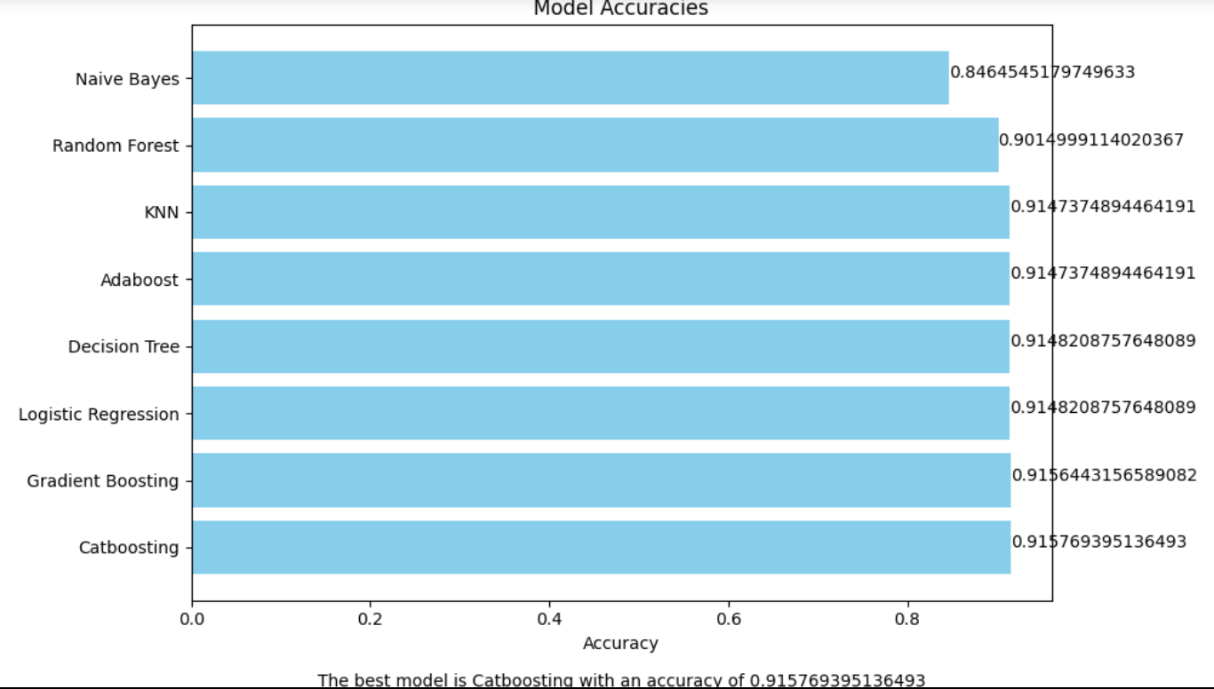
Model Evaluation (no-resampling)
Catboosting again came out to be the best model with an accuracy of 0.91% when we doesn’t resample the data.

Slide 17
THANK YOU…

